Slide 1

FORD AUTONOMOUS VEHICLE MARKET ANALYSIS
Presented by:
AMAN MAHAJAN
JAYENDRA BHARDWAJ
SHUBHAM MITTAL
AARZOO DAWRA
EMORY BOYLAND
Presented to: Prof. Chan Choi
Course Name: Marketing Research
Date: December 12, 2017

Slide 2
Industry Background
Car companies are collaborating with tech companies and prominent start ups to develop Autonomous Vehicles.
Why now
Technological advancements have made computer vision to distinguish various objects on road, build 3D map of the surrounding area and many other things.
To maximise profits, customer satisfaction has become major tool these days. And this can be attained by bringing Autonomous Vehicle in the market.
Future Prospects:
According to a study conducted by Intel economic value of Autonomous Vehicles will increase from $800 billion in 2035 (base year of study) to $7 trillion by 2050.

Slide 3
Research Purpose/Objectives
Statement of problem
Autonomous Technology is fast moving and motor vehicle companies are making large strides forward entering the autonomous vehicle segment.
Ford too wants to be the early movers in this competition.
But is the market ready for this new technology?
And should Ford invest in this new technology?
These are the topics of research.
Specific Research Objective
Are the customers willing to buy Autonomous Vehicles in future?
What features are they looking for in their future Autonomous Vehicle?
Potential Actionable Findings
Factors affecting the customer’s decision in buying an Autonomous Vehicle
Affect of brand loyalty, cost and trust issues on the Ford’s market share

Slide 4


Research Design
Conducted Survey using Google forms and received 47 responses
A survey of 15 questions designed keeping in view the affect of all the questions on our response question.
Descriptive Research
Characterizing customers’ demographics, behaviour and attitudes (occupation, age, income etc.)
Characterizing marketing situation
Characterizing situational behaviour
Analysis of these survey questions through SPSS with variables correlated to each other to predict the response variable “Your personal interest in acquiring a Self Driving (Autonomous) vehicle for your next vehicle purchase or lease”

Slide 5
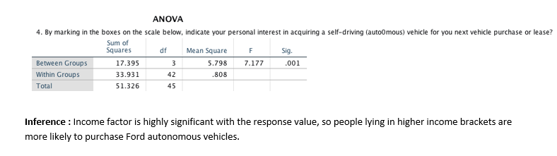
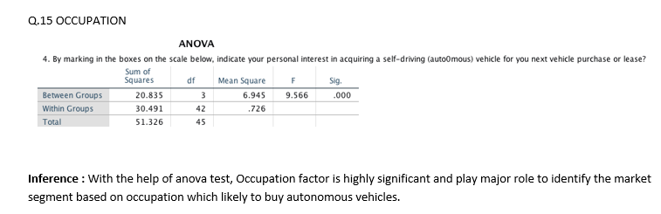
Analysis
1) Response (Q4) vs Income (Q14)
2) Response (Q4) vs Occupation (Q15)

Slide 6
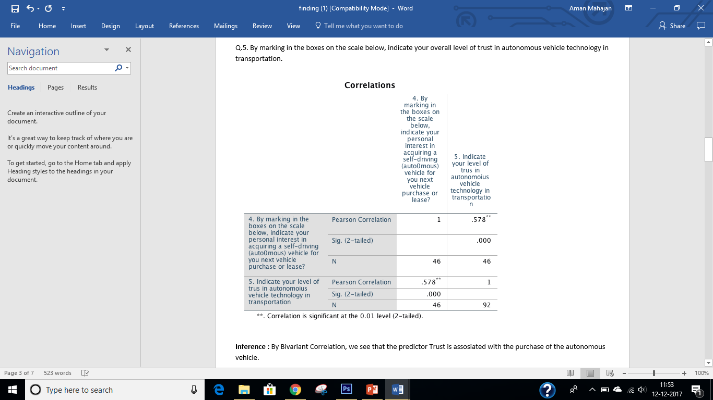
3) Response (Q4) vs Level of Trust (Q5)

Slide 7
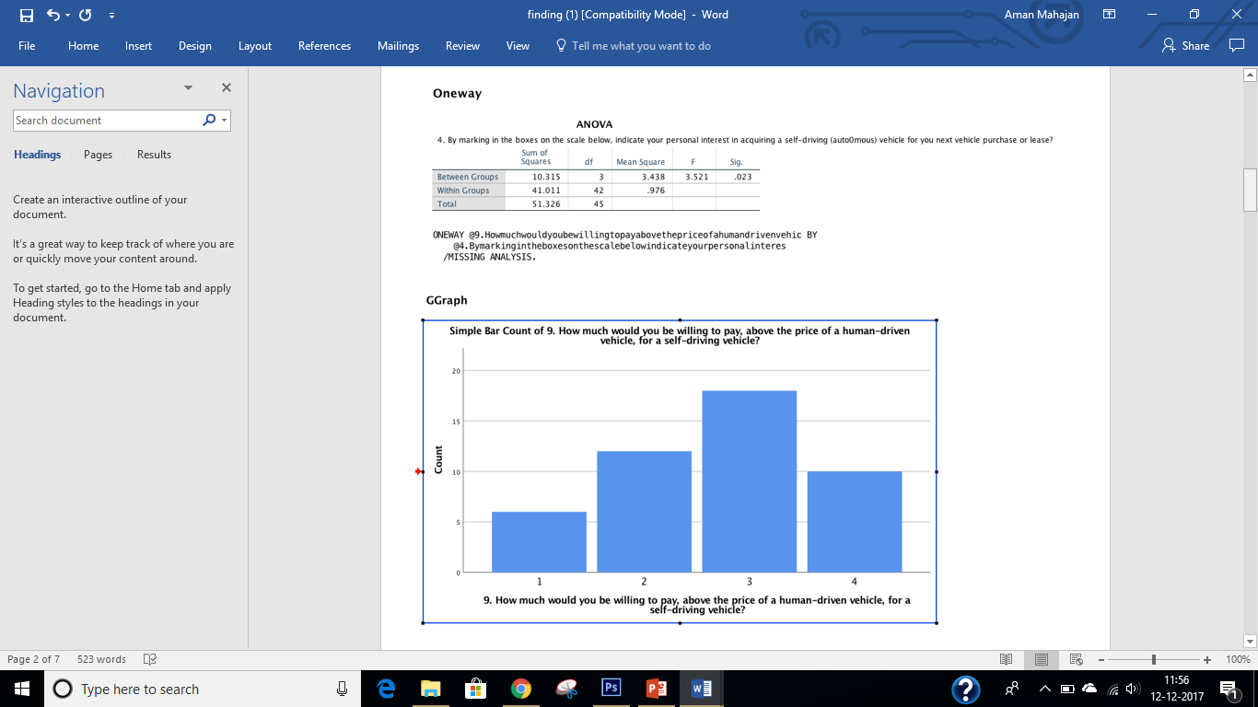
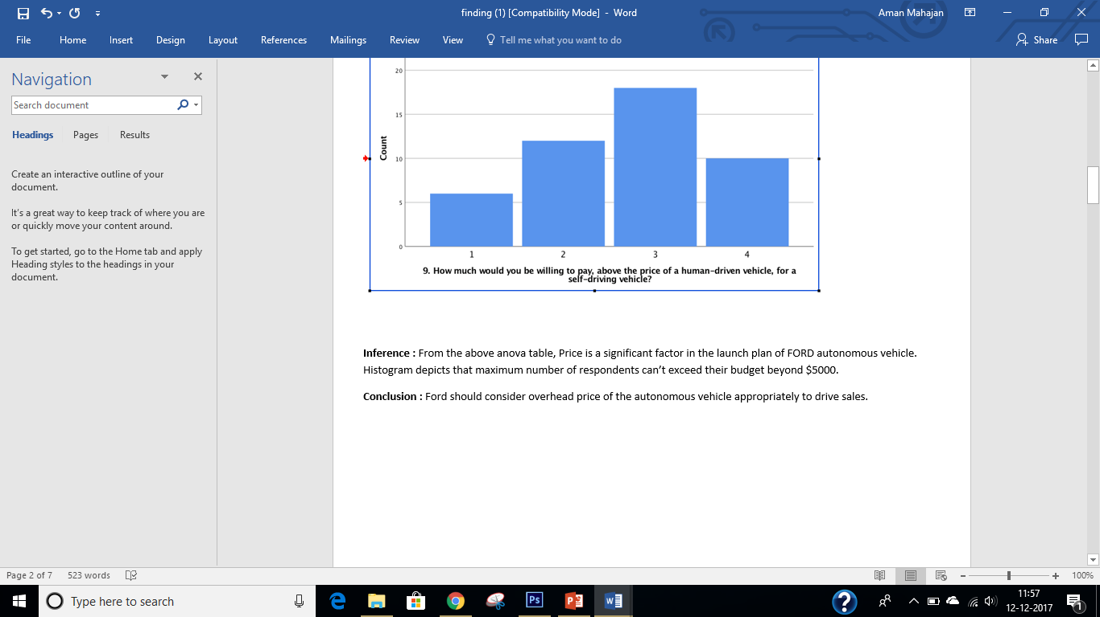
4) Response (Q4) vs Price above human-driven vehicle(Q9)

Slide 8
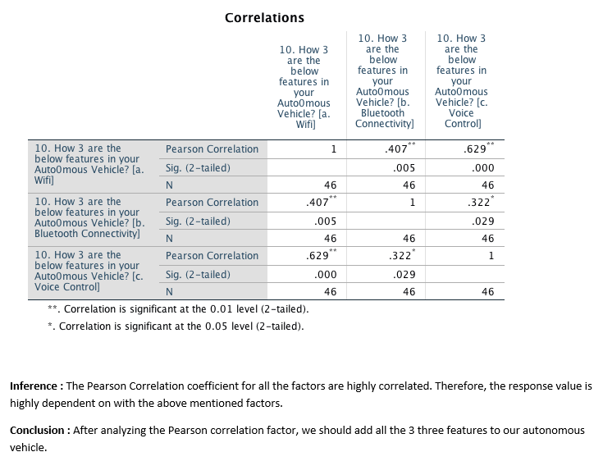
5) Response (Q4) vs In-vehicle Features(Q10)

Slide 9
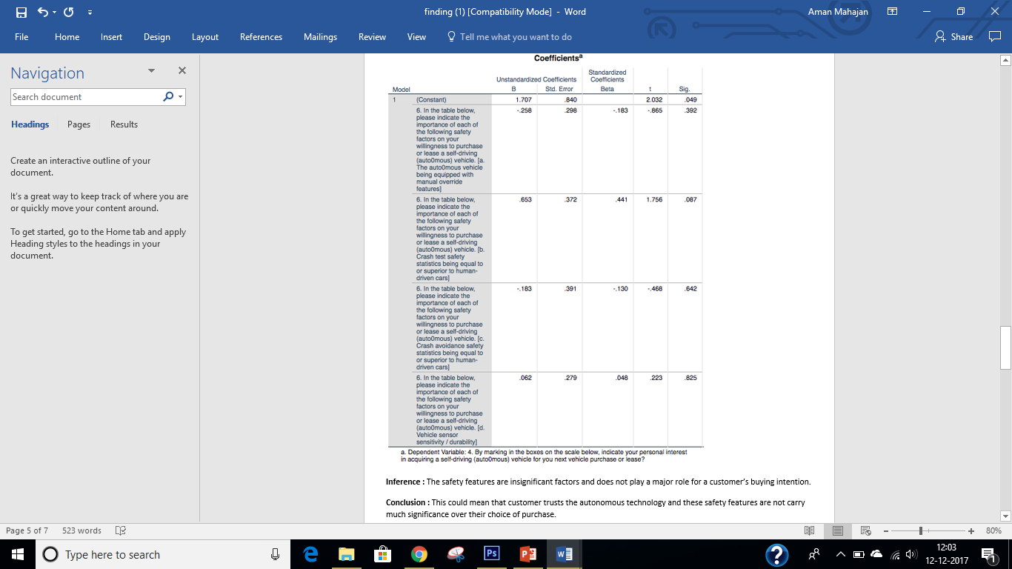
6) Response (Q4) vs Safety Features(Q6)

Slide 10
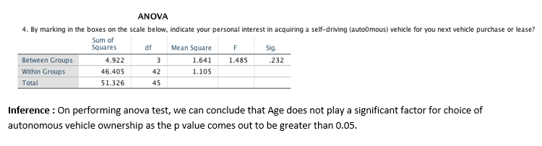
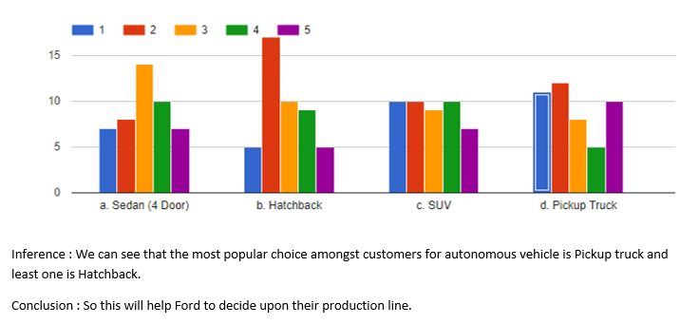
7) Response (Q4) vs Age(Q13)
8) Response (Q4) vs Choice of autonomous vehicle(Q11)

Slide 11
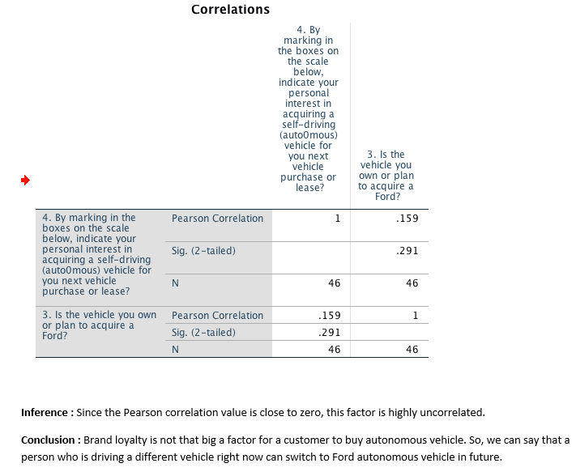
9) Response (Q4) vs Brand Loyalty(Q3)

Slide 12
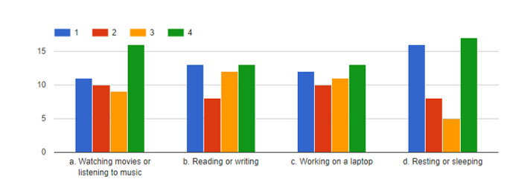

10) Response (Q4) vs Car time preference(Q12)

Slide 13
Conclusions
People are willing to pay above the price of a human-driven vehicle, for their autonomous vehicle and it plays a significant role in decision making of the potential customer.
Trust too is a highly significant factor for customers while purchasing an autonomous vehicle
Brand loyalty is not a highly significant factor for a customer when it comes to buying an autonomous vehicle, so this opens new customer acquisition opportunities for Ford.
Safety features does not carry much significance over the choice of purchase. This could mean that customers trusts the autonomous technology.
We can see that the most popular choice amongst customers for autonomous vehicle is Pickup truck and least one is Hatchback.
The Income factor is highly significant so people lying in higher income brackets are more likely to purchase Ford autonomous vehicles.
This Occupation factor is also highly significant and people belonging to Self employed and Business owner category are more likely to buy autonomous vehicles.

Slide 14
Recommendations
Based on these conclusions, we, as the Marketing Research company purpose the following recommendations to the FORD Motor Company.
Overall, there is a positive outcome of people general opinion towards their willingness to purchase autonomous vehicle therefore, Ford can go ahead with their production of autonomous vehicles in the market.
They should be including features like wifi, Bluetooth and voice control in the vehicle as it plays a significant part to push the sales.
People though are willing to pay extra for autonomous vehicles, but Ford should be price competitive and keep the price up to $5000 above the price of the manual driven car.
We have seen that factors like comfort, luxury and features play a more important role as compared to trust and safety from customer’s behaviour, so Ford should align their marketing campaign around these lines only.
Ford should not stick only to their present customers but other potential customers too as brand loyalty is not that significant factor.
Ford should launch more of pick up trucks and sedan autonomous vehicles and lesser hatchbacks as per customer’s likability.
Ford should target people who are business owner and self employed as their targeted customers.

Slide 15
THANK YOU

